Slide 1
Project Management

Slide 2
The project manager and project team have one shared goal: to carry out the work of the project for the purpose of meeting the project’s objectives.
Every project has a beginning, a middle period during which activities move the project toward completion, and an ending (either successful or unsuccessful).
A standard project typically has the following four major phases (each with its own agenda of tasks and issues):
initiation, planning, implementation, and closure.
Taken together, these phases represent the path a project takes from the beginning to its end and are generally referred to as the project “life cycle.”

Slide 3
Initiation Phase
The project objective or need is identified; this can be a business problem or opportunity.
An appropriate response to the need is documented in a business case with recommended solution options.
A feasibility study is conducted to investigate whether each option addresses the
project objective and a final recommended solution is determined.
Issues of feasibility (“can we do the project?”) and justification (“should we do the project?”) are addressed.

Slide 4
Once the recommended solution is approved, a project is initiated to deliver the approved solution and a project manager is appointed.
The major deliverables and the participating work groups are identified, and the project team begins to take shape. Approval is then sought by the project manager to move onto the detailed planning phase.

Slide 5
Planning Phase
The team identifies all of the work to be done. The project’s tasks and resource requirements are identified, along with the strategy for producing them. This is also referred to as “scope management.”
A project plan is created outlining the activities, tasks, dependencies, and timeframes.
The project manager coordinates the preparation of a project budget by providing cost estimates for the labour, equipment, and materials costs.
The budget is used to monitor and control cost expenditures during project implementation.

Slide 6
Once the project team has identified the work, prepared the schedule, and estimated the costs, the three fundamental components of the planning process are complete.
This is an excellent time to identify and try to deal with anything that might pose a threat to the successful completion of the project. This is called risk management.

Slide 7
In risk management, “high-threat” potential problems are identified along with the action that is to be taken on each high-threat potential problem, either to reduce the probability that the problem will occur or to reduce the impact
on the project if it does occur.
This is also a good time to identify all project stakeholders and establish a communication plan describing the information
needed and the delivery method to be used to keep the stakeholders informed.
Finally, you will want to document a quality plan, providing quality targets, assurance, and control measures, along with an acceptance plan, listing the criteria to be met to gain customer acceptance. At this point, the project would have been
planned in detail and is ready to be executed.

Slide 8
Implementation (Execution) Phase
During the third phase, the implementation phase, the project plan is put into motion and the work of the project is performed. It is important to maintain control and communicate as needed during implementation.
Progress is continuously monitored and appropriate adjustments are made and recorded as variances from the original plan.
In any project, a project manager spends most of the time in this
step. During project implementation, people are carrying out the tasks, and progress information is being reported through regular team meetings.

Slide 9
The first course of action should always be to bring the project back on course (i.e., to return it to the original plan). If that cannot happen, the team should record variations from the original plan and record and publish modifications to the plan.
Throughout this step, project sponsors and other key stakeholders should be kept informed of the project’s status according to the agreed-on frequency and format of communication.
The plan should be updated and published on a regular basis. Status reports should always emphasize the anticipated end point in terms of cost, schedule, and quality of deliverables.
Each project deliverable produced should be reviewed for quality and measured against the acceptance criteria. Once all of the deliverables have been produced and the customer has accepted the final solution, the project is ready for closure.

Slide 10
Closing Phase
During the final closure, or completion phase, the emphasis is on releasing the final deliverables to the customer, handing over project documentation to the business, terminating supplier contracts, releasing project resources, and communicating the
closure of the project to all stakeholders.
The last remaining step is to conduct lessons-learned studies to examine what went well and what didn’t.
Through this type of analysis, the wisdom of experience is transferred back to the project organization, which will help future project teams.

Slide 11
Act with Prudence
No matter how comfortable a schedule looks at the beginning of
an iteration, you can’t avoid being under pressure some of the time. If you find yourself having to choose between “doing it right” and “doing it quick,” it is often appealing to “do it quick” with the understanding that you’ll come back and fix it later.
When you make this promise to yourself, your team, and your
customer, you mean it. But all too often, the next iteration brings new problems and you become focused on them. This sort of deferred work is known as technical debt,

Slide 12
Ask, “What Would the User Do?” (You Are Not the User)
We all tend to assume that other people think like us. But they don’t. Psychologists call this the false consensus bias. When people think or act differently from us, we’re quite likely to label them (subconsciously) as defective in some way.
This bias explains why programmers have such a hard time putting themselves
in the users’ position. Users don’t think like programmers. For a start, they spend
much less time using computers. They neither know nor care how a computer
works.
This means they can’t draw on any of the battery of problem-solving
techniques so familiar to programmers. They don’t recognize the patterns and
cues programmers use to work with, through, and around an interface.
The best way to find out how a user thinks is to watch one. Ask a user to
complete a task using a similar piece of software to what you’re developi

Slide 13
Automate Your Coding Standard
There exists a wealth of tools that can be used to produce code quality reports
and to document and maintain the coding standard, but that isn’t the whole
solution. It should be automated and enforced where possible. Here are a few
examples:
• Make sure code formatting is part of the build process, so that everybody
runs it automatically every time they compile the code.
• Use static code analysis tools to scan the code for unwanted anti patterns.
If any are found, break the build.
• Learn to configure those tools so that you can scan for your own, project specific anti patterns.
• Do not only measure test coverage, but automatically check the results,
too. Again, break the build if test coverage is too low.

Slide 14
Beauty Is in Simplicity
In one sentence, this sums up the values that we as software developers should aspire to.
There are a number of things we strive for in our code:
• Readability
• Maintainability
• Speed of development
• The quality

Slide 15
Before You Refactor
The best approach for restructuring starts by taking stock of the existing codebase and the tests written against that code.
Avoid the temptation to rewrite everything. It is best to reuse as much code as possible. No matter how ugly the code is, it has already been tested, reviewed, etc.

Slide 16
Check Your Code First Before Looking to Blame Others
When someone else is reporting a problem you cannot duplicate, go and see
what they are doing. They may be doing something you never thought of or
are doing something in a different order.
Multithreaded problems are another source of bugs that turn hair gray and
induce screaming at the machine. All the recommendations to favor simple
code are multiplied when a system is multithreaded. Debugging and unit tests cannot be relied on to find such bugs with any consistency, so simplicity of design is paramount.

Slide 17
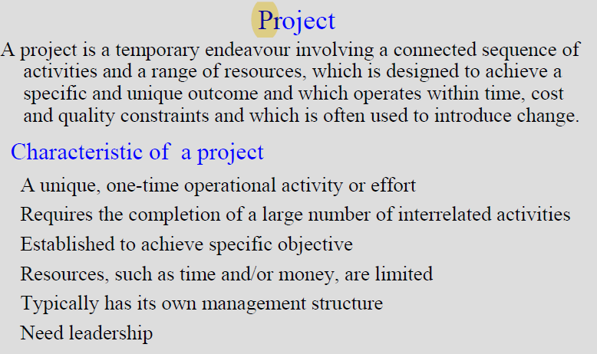

Slide 18
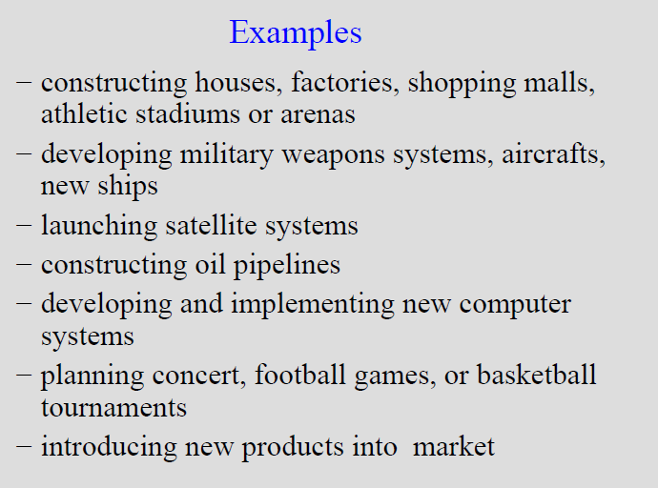

Slide 19
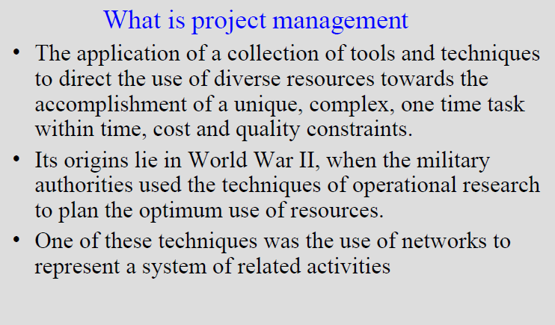

Slide 20
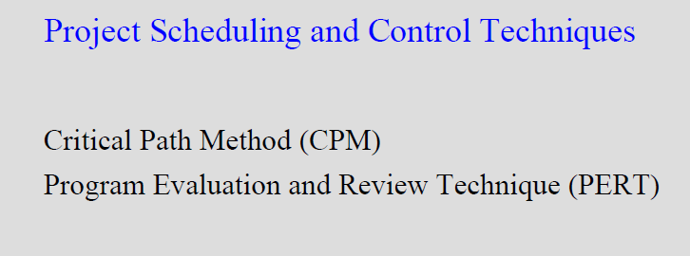

Slide 21
Network analysis is one of the important tools for project management.
Whether major or minor a project has to be completed in a definite time & at a definite cost.
The necessary information of any particular data can be represented as a project network.
These techniques are very useful for planning, scheduling and executing large-time bound projects involving careful co-ordination of variety of complex and interrelated activities

Slide 22
Applications of network analysis
Planning, scheduling, monitoring and control of large and complex projects.
Construction of factories, highways, building, bridges, cinemas etc.
Helpful to army for its missile development.
Assembly line scheduling
Installation of computers and high tech machineries
To make marketing strategies

Slide 23
Methodology Involved in Network Analysis
Describing the Project
Diagramming the network
Estimating the time of completion
Deterministic
estimates
Probabilistic
estimates
Monitoring the project progress

Slide 24
Key terminology
Activity : All projects may be viewed as composed of activities. It is the smallest unit of work consuming both time& resources that project manager should schedule & control.
An activity is represented by an arrow in network diagram
The head of the arrow shows sequence of activities.

Slide 25
Event
The beginning & end of an activities are called as events .
Events are represented by numbered circles called nodes.
i
i
Event start
Event finish

Slide 26
Classification of activities
Predecessor activity: Activities that must be completed immediately prior to the start of another activity are called predecessor activities.
Successor activity : activities that cannot be started until one or more of other activities are completed but immediately succeed them are called successor activities.
Concurrent activities: activities that can be accomplished together are known as concurrent activities.
Dummy activity: An activity which does not consume any resource but merely depicts the dependence of one activity on other is called dummy activity. It is introduced in a network when two or more parallel activities have the same start and finish nodes.

Slide 27
Path & Network
An unbroken chain of activity arrows connecting the initial event to some other event is called a path.
A network is the graphical representation of logically & sequentially connected arrows & nodes representing activities & events of a project . It is a diagram depicting precedence relationships between different activities.

Slide 28
Errors in network logic
Looping : looping is known as cycling error and creates an impossible situation and it appears that none of the activities could ever be completed.
Dangling : sometimes a project network includes an activity which does not fit into the end objective of the project and is carried out without any result related with completion of the project . Such an error in network is called dangling

Slide 29
Guidelines for Network Construction
A complete network diagram should have one stand point & one finish point.
The flow of the diagram should be from left to right.
Arrows should not be crossed unless it is completely unavoidable.
Arrows should be kept straight & not curved or bent.
Angle between arrows should as large as possible.
Each activity must have a tail or head event.. No two or more activities may have same tail & head events.
Once the diagram is complete the nodes should be numbered from left to right. It should then be possible to address each activity uniquely by its tail & head event

Slide 30
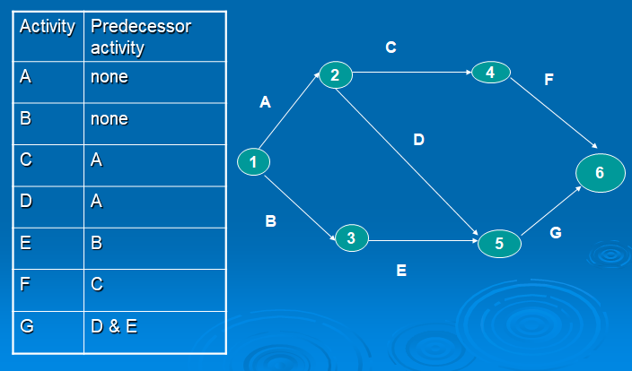

Slide 31
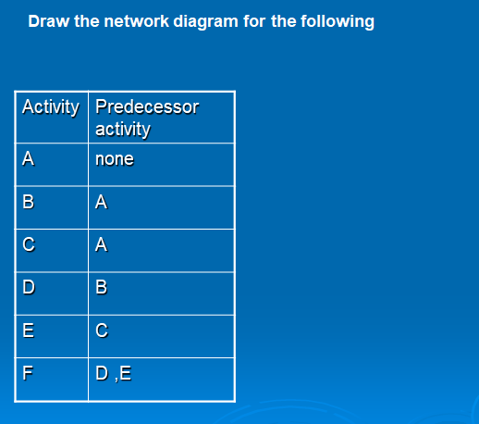

Slide 32
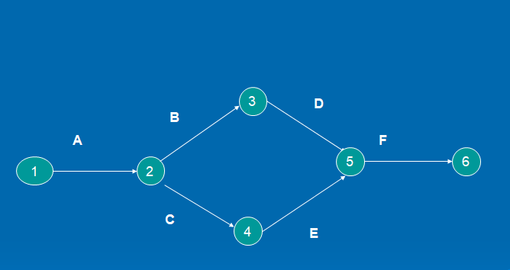

Slide 33
Critical path
The critical path is the longest path in the network from the starting event to ending event & defines the minimum time required to complete the project.
The critical path is denoted by darker or double lines

Slide 34
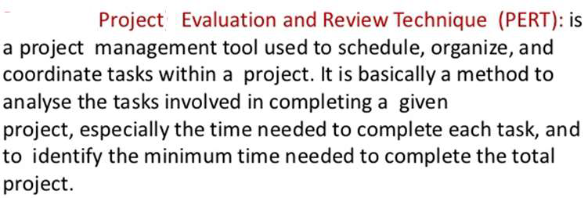

Slide 35
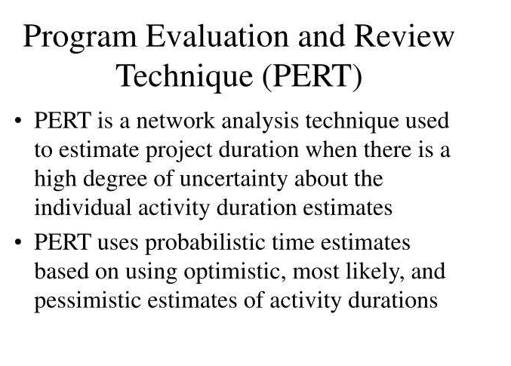

Slide 36
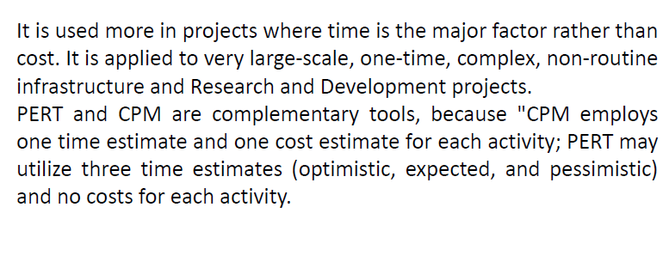

Slide 37
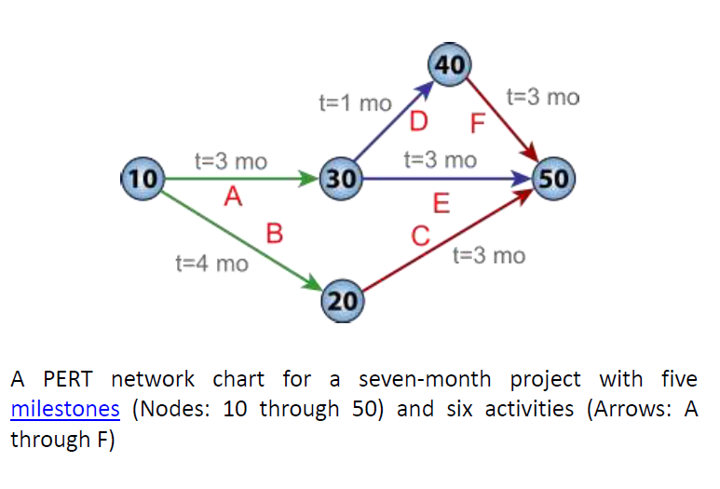

Slide 38
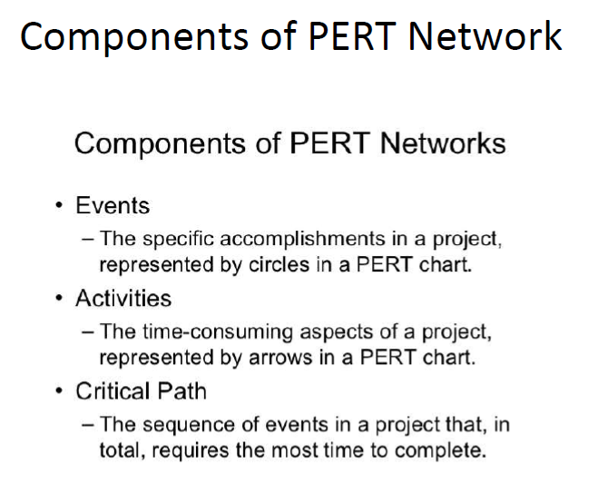

Slide 39
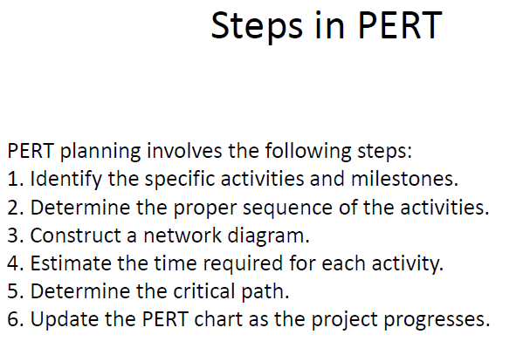

Slide 40
Human Aspects of Project Management
Project provides special conditions for project team members whom these conditions can have different effects on them, because it has special properties (it has a given beginning and end, limited resources and uniqueness)
These effects in some cases can cause human resource efficiency reduction during performing the project.
For example, work pressure and abundant stress resulting from performing project activities are not comparable to work pressure of current activities in organization.
On the other hand, increasing and decreasing of human resource during the project is so variable, whereas the effort level of human resource in non-project activities of organization is almost monotonous.

Slide 41
Role of human resources in project
In most of the projects in spite of non-project activities, human resource plays a more important role than other work factors like machines, approaches, materials etc.
In a productive factory, it is possible that according to producing automation, Job dissatisfaction of workers has no much effect on production volume, but during executing a project job dissatisfaction of welding technician will have a high effect on the amount of project progression

Slide 42
Role of motivation in project
The necessity of effort for change keeping or increasing human resource productively in project will be very large. One of the most effective factors on increasing job satisfaction and consequently increasing efficiency of human resource is increasing motivation. The way of retention and increasing employees' motivation in project activities regarding to special features of projects is different from non-project activities.

Slide 43
Effective factors on reducing motivation
The main cases which cause motivation decrease are:
• Losing the support of chief officer by project team member
• Individual conflicts between project team members
• Not conducive working environment
• Not using expertise in jobs
• Not obligatory according to the needs of employees
• Job insecurity
• Injustice in rewarding system
• Time conflicts (project resources timing)
• Time and cost increase of project
• The fear of being fired after finishing the project
• High fluctuation in individuals activities level

Slide 44
Method of rising motivation in organizations
Most of the motivation increase methods in project team are focused on communications. Sufficient authority to the staff, so they have more responsibility in their work .
Trying to staff participation in decision making and setting goals and programs that; This will result in the employee performance in achieving organizational goals and feel responsible to do more updates
Establishing an appropriate system of performance-based pay system and to establish discipline and encouragement.
Increasing communications between project team members and providing a transparent environment and without ambiguity happen to increase people's motivation in project team. This environment will cause to reduce conflicts between project team members and positive feedbacks in respect to efficiency increase to be represented.

Slide 45
On the other hand, contributing project team members to discussions and decision makings will help people to represent their inner abilities and skills.
Researches have showed that people's motivation is high at the beginning of the project and by elapsing time and approaching to the end of is reduced. This can have several reasons, such as work volume increase of project team, concerns about job status after the project being finished, time project becoming long and concerns about its failure.
In addition, over time most of the project managers allocate more time to technical and executive activities of the project and they less deal with soft activities like motivation, communications etc. thus, it is important that project managers consider final steps more.

Slide 46
Assessment of Tax Burden
Taxes are the compulsory contribution by the citizens of a country for meeting different government expenditures. There are three stages in the imposition of tax by the government. First step is the declaration of the liability by the Government i.e. what are all the incomes chargeable to tax, second one is the assessment and tax payment by persons and the last one is the method of recovery of tax if tax was not paid on time. Tax planning and management focuses efficient administration of tax procedures and minimization of tax liability through eligible schemes.

Slide 47
TAX PLANNING
Tax Planning is an exercise undertaken to minimize tax liability through the best use of all available exemptions, deductions, rebates and reliefs to reduce income. Tax planning can be defined as an arrangement of one’s financial and business affairs by taking legitimately in full benefit of all deductions, exemptions, allowances, reliefs and rebates so that tax liability reduces to minimum. In other words, all arrangements by which the tax is saved by ways and means

Slide 48
TAX EVASION
It refers to a situation where a person tries to reduce his tax liability by deliberately suppressing the income or by inflating the expenditure showing the income lower than the actual income and resorting to various types of deliberate manipulations.
An assessee guilty of tax evasion is punishable under the relevant laws. Under direct tax laws provisions have been made for imposition of heavy penalty and institution of prosecution proceeding against tax evaders.
The tax evaders reduce his taxable income by one or more of the following steps:
Non-disclosure of capital gains on sale of asset.
Willfully unrecording or partial recording of incomes. Eg: sales, rent, fees, etc.
Charging personal expenses as business expenses. Eg: car expenses, telephone expenses, medical expenses incurred for self or family recorded in business books.
Submission of bogus receipts for charitable donations under section 80 G.

Slide 49
TAX AVOIDANCE
Tax avoidance is a method reducing tax incidence by availing of certain loopholes in the law.
The line of demarcation between tax planning and tax avoidance is very thin and blurred. Any planning which, though done strictly according to legal requirements, defeats the basic intention of the Legislature behind the statute could be termed as instance of tax avoidance. It is usually done by taking full advantage of loopholes adjusting the affairs in such a manner that there is no infringement of taxation laws and least taxes are attracted.

Slide 50
TAX MANAGEMENT
Tax management refers to compliance with the income tax rules and regulations. Tax management covers matters relating to
Taking steps to avail various tax incentives
Compliance with tax rules and regulations (including timely filing of return)
Protecting from consequences of non-compliance of tax rules and regulations. i.e. penalties, prosecution etc.
Review of departments orders and if need apply for rectification of mistake, filing appeal, tax revision or settlement of tax cases.
AREAS OF TAX MANAGEMENT Important areas of tax management are discussed below:
1. TDS (Tax Deducted at Source): Persons responsible for deducting tax at source should deduct from the income and that should be paid to the central government on time. Moreover he should issue deduction certificate to the deductee’s and file it in the income tax website.
2. Collection of tax at source: In some special cases, some persons responsible for collecting the tax at source from the buyers (sec 206C). They should comply with those formalities.

Slide 51
3. Payment of tax: It includes
Payment of advance tax
Payment of tax on self-assessment.
Payment of tax on demand (payment after receiving notice from authorities)
4. Maintenance of books of accounts: Every businessman or a professional must maintain books of accounts and other relevant documents so that the tax can be computed accurately and verified by the Assessing Officer. Maintenance of account books, vouchers, bills, correspondence and agreements, etc. is a part of tax management.

